Slide 1
8051 Serial Port

Slide 2
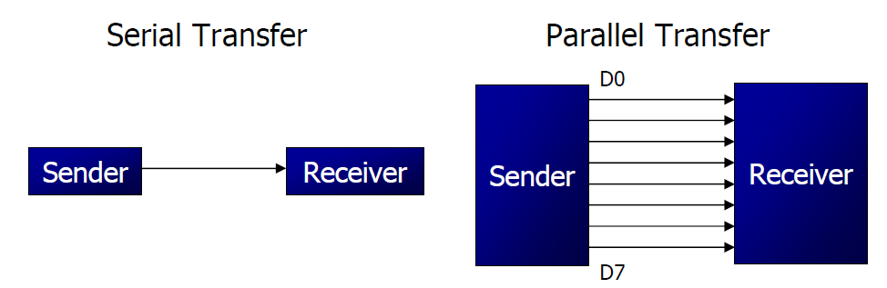
Basics of Serial Communication
Computers transfer data in two ways:
Parallel: Often 8 or more lines (wire conductors) are used to transfer data to a device that is only a few feet away.
Serial: To transfer to a device located many meters away, the serial method is used. The data is sent one bit at a time.

Slide 3
Basics of Serial Communication
Serial data communication uses two methods
Synchronous method transfers a block of data at a time
Asynchronous method transfers a single byte at a time
There are special IC’s made by many manufacturers for serial communications.
UART (universal asynchronous Receiver transmitter)
USART (universal synchronous-asynchronous Receiver-transmitter)

Slide 4
Asynchronous – Start & Stop Bit
Asynchronous serial data communication is widely used for character-oriented transmissions
Each character is placed in between start and stop bits, this is called framing.
Block-oriented data transfers use the synchronous method.
The start bit is always one bit, but the stop bit can be one or two bits
The start bit is always a 0 (low) and the stop bit(s) is 1 (high)

Slide 5
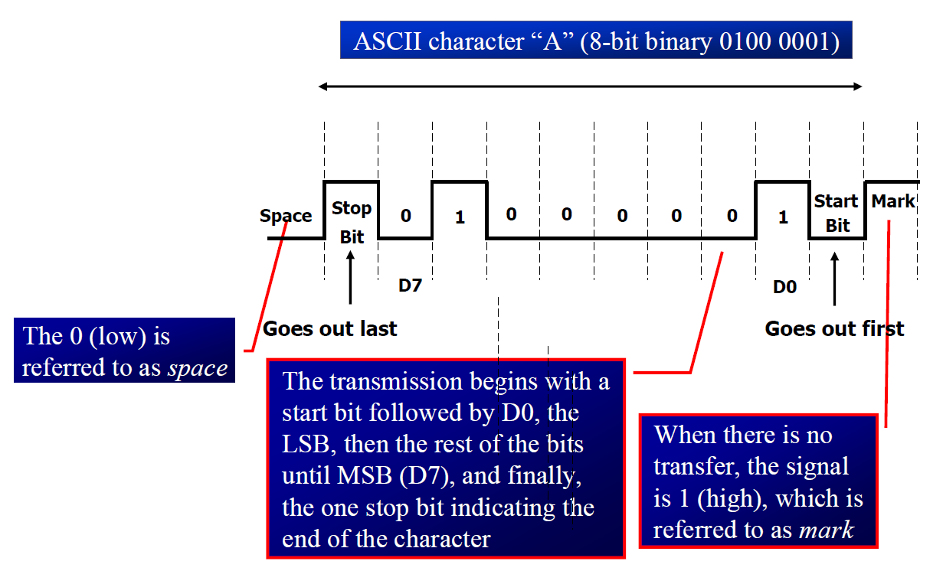
Asynchronous – Start & Stop Bit

Slide 6
Data Transfer Rate
The rate of data transfer in serial data communication is stated in bps (bits per second).
Another widely used terminology for bps is baud rate.
It is modem terminology and is defined as the number of signal changes per second
In modems, there are occasions when a single change of signal transfers several bits of data
As far as the conductor wire is concerned, the baud rate and bps are the same.

Slide 7
8051 Serial Port
Synchronous and Asynchronous
SCON Register is used to Control
Data Transfer through TXd & RXd pins
Some time - Clock through TXd Pin
Four Modes of Operation:
Mode 0 :Synchronous Serial Communication
Mode 1 :8-Bit UART with Timer Data Rate
Mode 2 :9-Bit UART with Set Data Rate
Mode 3 :9-Bit UART with Timer Data Rate

Slide 8
Registers related to Serial Communication
SBUF Register
SCON Register
PCON Register

Slide 9
SBUF Register
SBUF is an 8-bit register used solely for serial communication.
For a byte data to be transferred via the TxD line, it must be placed in the SBUF register.
The moment a byte is written into SBUF, it is framed with the start and stop bits and transferred serially via the TxD line.
SBUF holds the byte of data when it is received by 8051 RxD line.
When the bits are received serially via RxD, the 8051 deframes it by eliminating the stop and start bits, making a byte out of the data received, and then placing it in SBUF.

Slide 10
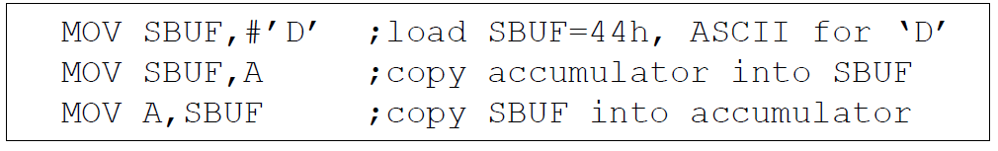
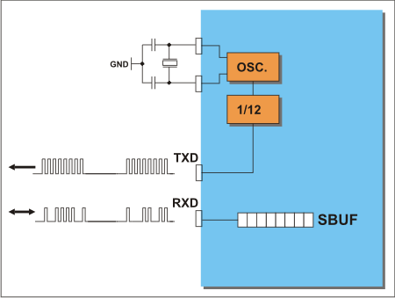
SBUF Register
Sample Program:

Slide 11
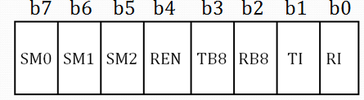
SCON Register
Set to Enable
Serial Data
reception
Enable Multiprocessor
Communication Mode
Set when Stop bit Txed
9th Data Bit
Sent in Mode 2,3
SM0 | SM1 | Mode | Description
0 | 0 | 0 | 8-bit Shift Register
0 | 1 | 1 | 8-bit UART
1 | 0 | 2 | 9-bit UART
1 | 1 | 3 | 9-bit UART
Set when a Character received
9th Data Bit
Received in Mode 2,3

Slide 12
8051 Serial Port – Mode 0
The Serial Port in Mode-0 has the following features:
Serial data enters and exits through RXD
TXD outputs the clock
8 bits are transmitted / received
The baud rate is fixed at (1/12) of the oscillator frequency

Slide 13
8051 Serial Port – Mode 1
The Serial Port in Mode-1 has the following features:
Serial data enters through RXD
Serial data exits through TXD
On receive, the stop bit goes into RB8 in SCON
10 bits are transmitted / received
Start bit (0)
Data bits (8)
Stop Bit (1)
Baud rate is determined by the Timer 1 over flow rate.

Slide 14
8051 Serial Port – Mode 2
The Serial Port in Mode-2 has the following features:
Serial data enters through RXD
Serial data exits through TXD
9th data bit (TB8) can be assign value 0 or 1
On receive, the 9th data bit goes into RB8 in SCON
11 bits are transmitted / received
Start bit (0)
Data bits (9)
Stop Bit (1)
Baud rate is programmable

Slide 15
8051 Serial Port – Mode 3
The Serial Port in Mode-3 has the following features:
Serial data enters through RXD
Serial data exits through TXD
9th data bit (TB8) can be assign value 0 or 1
On receive, the 9th data bit goes into RB8 in SCON
11 bits are transmitted / received
Start bit (0)
Data bits (9)
Stop Bit (1)
Baud rate is determined by Timer 1 overflow rate.

Slide 16
Programming Serial Data Transmission
1. TMOD register is loaded with the value 20H, indicating the use of timer 1 in mode 2 (8-bit auto-reload) to set baud rate.
2. The TH1 is loaded with one of the values to set baud rate for serial data transfer.
3. The SCON register is loaded with the value 50H, indicating serial mode 1, where an 8- bit data is framed with start and stop bits.
4. TR1 is set to 1 to start timer 1
5. TI is cleared by CLR TI instruction
6. The character byte to be transferred serially is written into SBUF register.
7. The TI flag bit is monitored with the use of instruction JNB TI, xx to see if the character has been transferred completely.
8. To transfer the next byte, go to step 5

Slide 17
Programming Serial Data Reception
1. TMOD register is loaded with the value 20H, indicating the use of timer 1 in mode 2 (8-bit auto-reload) to set baud rate.
2. TH1 is loaded to set baud rate
3. The SCON register is loaded with the value 50H, indicating serial mode 1, where an 8- bit data is framed with start and stop bits.
4. TR1 is set to 1 to start timer 1
5. RI is cleared by CLR RI instruction
6. The RI flag bit is monitored with the use of instruction JNB RI, xx to see if an entire character has been received yet
7. When RI is raised, SBUF has the byte, its contents are moved into a safe place.
8. To receive the next character, go to step 5.

Slide 18
Doubling Baud Rate
There are two ways to increase the baud rate of data transfer
By using a higher frequency crystal
By changing a bit in the PCON register

Slide 19
PCON register
PCON register is an 8-bit register.
When 8051 is powered up, SMOD is zero
We can set it to high by software and thereby double the baud rate.
SMOD Baud rate is twice as much higher by setting this bit.
GF1 General-purpose bit (available for use).
GF0 General-purpose bit (available for use).
PD By setting this bit the microcontroller enters the Power Down mode.
IDL By setting this bit the microcontroller enters the Idle mode.

Slide 20
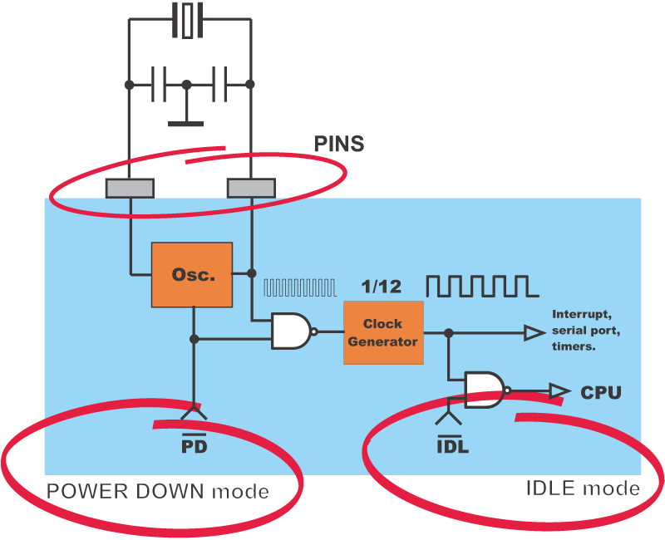

Slide 21

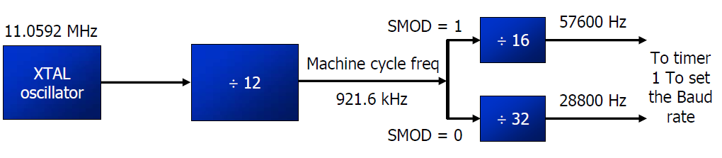
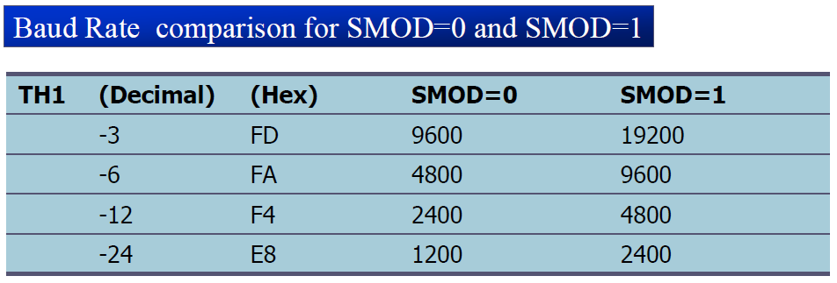
Doubling Baud Rate (cont…)

